Slide 1

Smart Blind Stick
Presented by Prerak, Ahan, Utsav, Shubham

Slide 2

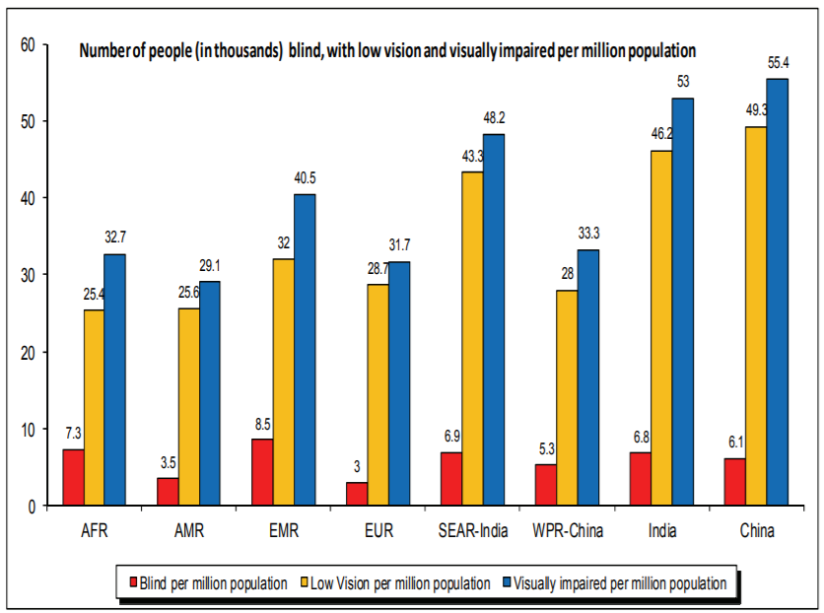
Some statistics from WHO
http://www.who.int/blindness/GLOBALDATAFINALforweb.pdf

Slide 3
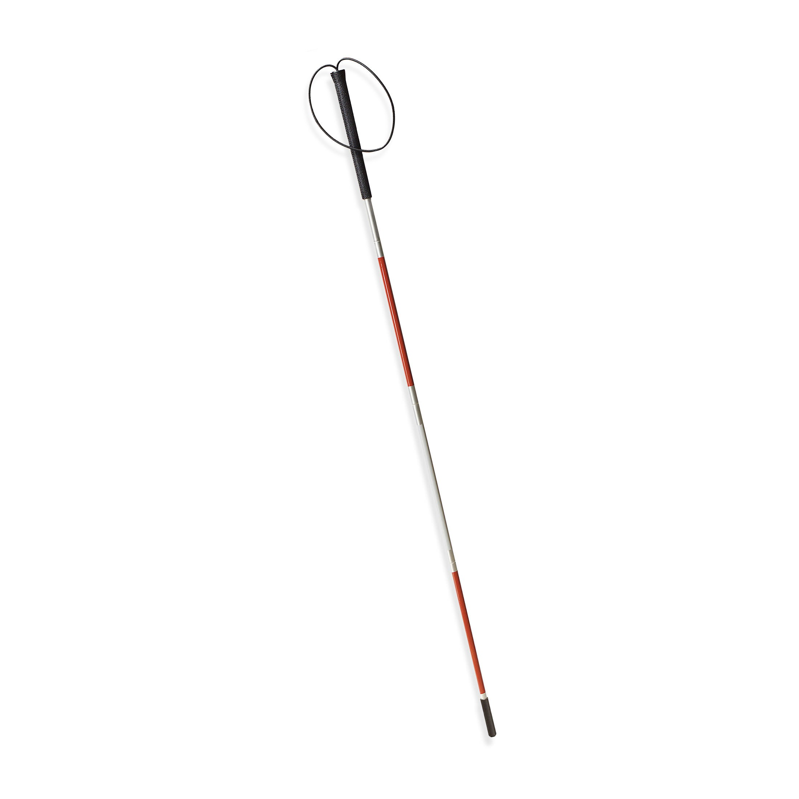
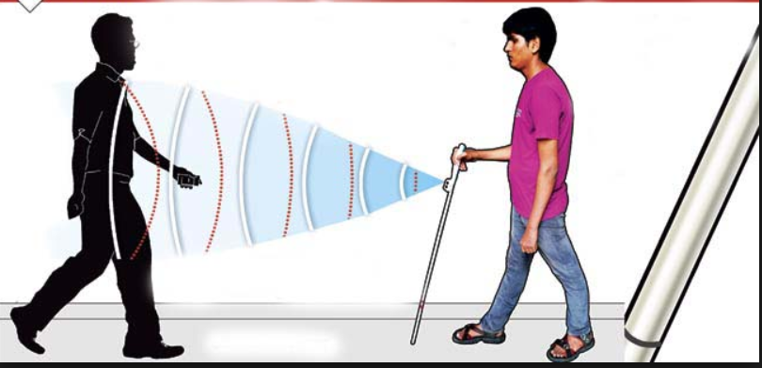
Old vs New

Slide 4
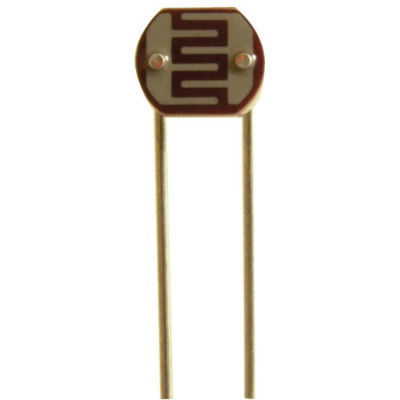

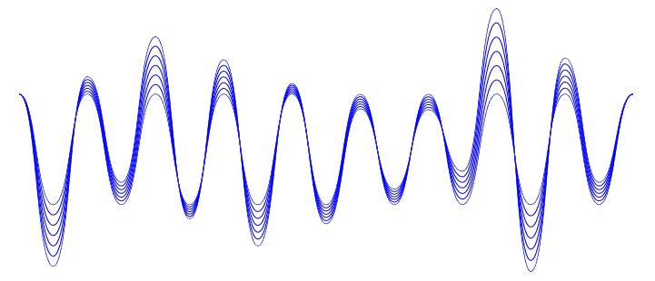
Light Dependent Resistor
This is the sensor
How it operates

Slide 5
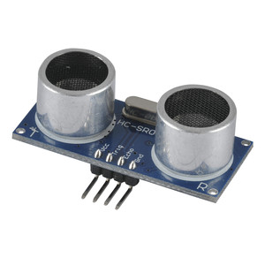

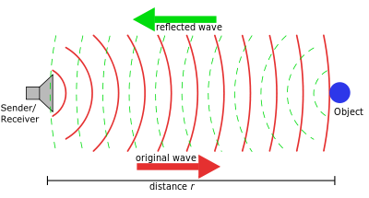
Sensors used
Dual Ultrasonic sensor

Slide 6
New > Old
Disadvantages
Runs on battery so needs to be replaced
Isn’t water proof
Advantages
Provides auditory feedback
Unique sounds for different situations
Multiple sensors
Higher range
Provides the user with a sense range
Easy to located if dropped or lost

Slide 7
Thank you, Presented BY: Prerak soni Ahan debray Utsav sharma Shubham singh rathore

